Slide 1
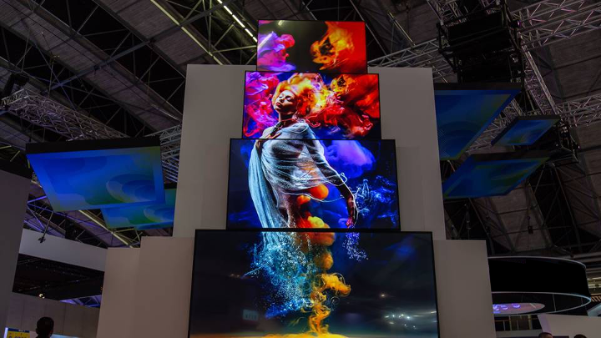

Introducing
Access II Series
Discrete LCD panels
August 2020

Slide 2

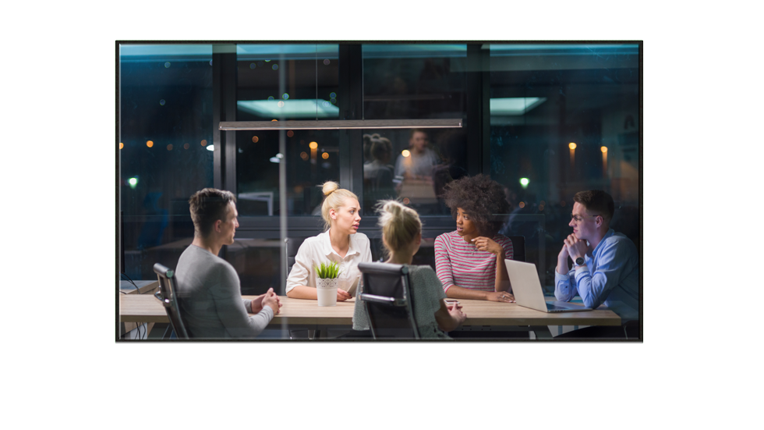
Full-featured discrete LCD displays
The Christie® Access II Series is the ideal solution when you need an affordable, performance-focused display
Perfect for meetings rooms and retail applications
Access II Series combines professional features in a sleek budget-friendly platform
Updated 86” panel (UHD862-L)
Updated 75” panel (UHD862-L)

Slide 3


A great fit in the professional large format LCD market
Commercial Display
Advanced Performance Commercial Displays
Price
Access II Series
Prosumer
250-350 Nits
300-450 Nits
500-700 Nits
Performance

Slide 4
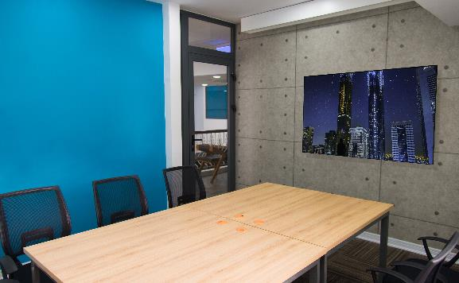
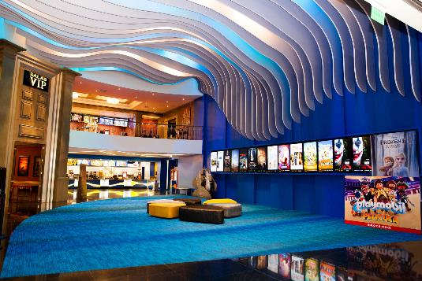
Access II Series is great for many markets & applications!
Corporate – Conference & Boardrooms
Meeting rooms
Collaboration
War rooms
Visualization labs
Digital Signage
Retail
Museums
Public venues
Education

Slide 5
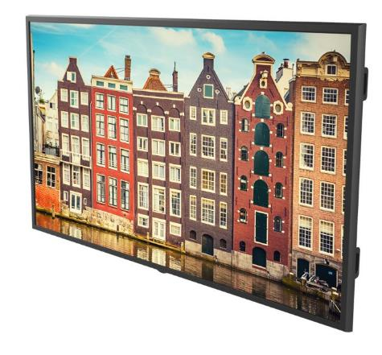
Next Generation Access Series
Key features
Competitively priced lineup of standard performance 4k commercial displays
Range of sizes 55”, 65”, 75”, 86”, and 98”
400-500 nits brightness – brightest in category!
Latest connectivity (HDMI 2.0, DP, USB-C)
Attractive slim design that is ADA compliant
OPS for flexible expansion
Crestron connected, Source Failover, CEC, Miracast

Slide 6
Feature improvements from generation I to II
Smaller bezel
Slimmer depth
Modern input connectivity
4k@60Hz on DP 1.2 input
HDR
55” and 65” improved brightness
Improved power standby modes
ADA compliance
Optional Wi-Fi module
Low latency mode
Real time Scheduled commands (On/Off)
Wi-Fi available via optional dongle

Slide 7
Access II Series summary of specifications
 | UHD552-L | UHD652-L | UHD752-L | UHD862-L | UHD982-P
Size | 55” | 65” | 75” | 86” | 98”
Brightness (Typ) | 500 nits |  | 400 nits | 410 nits | 350 nits
Orientation | Landscape Only |  |  |  | Landscape and Portrait
Operation | 16 hrs per day/ 7 days a week |  |  |  | 24/7
Input | 4x HDMI 2.0, DP 1.2, VGA, YPbPr, USB-C, OPS
Control | RS232, Ethernet, IR, Crestron Connected
Dims | 1238 x 711 x 63 mm | 1455 x 834 x 71 mm | 1684 x 967 x 100 mm | 1928 x 1099 x 80 mm | 2236 x 1292 x 98mm
Features | HDR10 support, Auto source switching, HDMI and DP1.2 Output, Video wall mode, USB Media playback, Wake on LAN, SB327 compliance , On/off scheduling, CEC, 10W built-in speakers, removable handles and badging

Slide 8


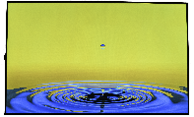
A full discrete line-up
Higher performance, non-RF & TAA compliant
Secure Series
55”, 65”, 75” & 86” 98” (SUHD983-P)
Price-competitive, industry standard performance
FHD55-XE- H
Price
Access II Series
55”, 65”, 75”, 86” & 98”
Performance

Slide 9

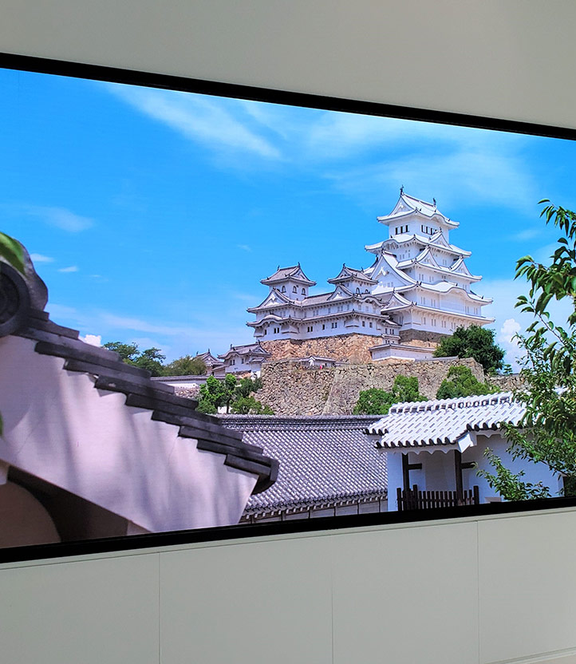
Christie offers
Competitively priced high performance products
Highest brightness in product category
More and better input connectivity
A full line of display technologies
Complete system solution

